Slide 1
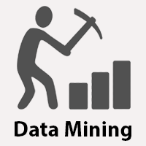

Slide 2
Data Mining
The non-trivial extraction of implicit,previously unknown and potentially usefull knowledge from data in large data repositories.
Data: The raw material of Information is called data.
Information:Data organized and presented by someone.

Slide 3
Why do we need Data Mining?
1.Data mining is the procedure of capturing large sets of data in order to identify the insights and visions of that data. Nowadays, the demand of data industry is rapidly growing which has also increased the demands for data analysts and data scientists.
2.With this technique, we analyze the data and then convert that data into meaningful information. This helps the business to take accurate and better decisions in an organization.
3.Data mining helps to develop smart market decision, run accurate campaigns, make predictions, and more.
4.With the help of Data mining, we can analyze customer behaviors and their insights. This leads to great success and data-driven business.

Slide 4
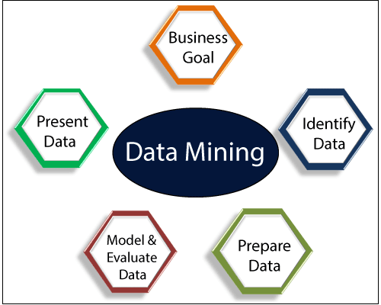

Slide 5
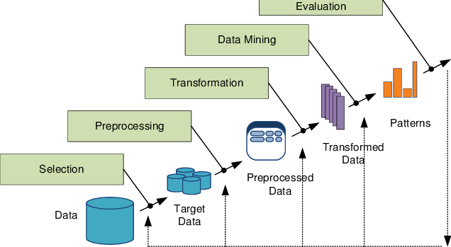
KDD Process(Knowledge Discovery in Databases)

